Slide 1
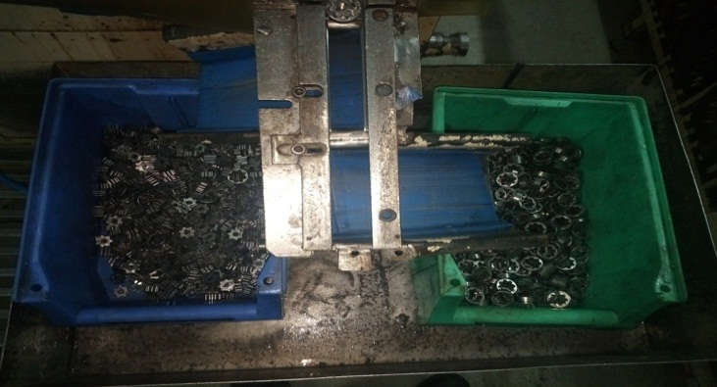
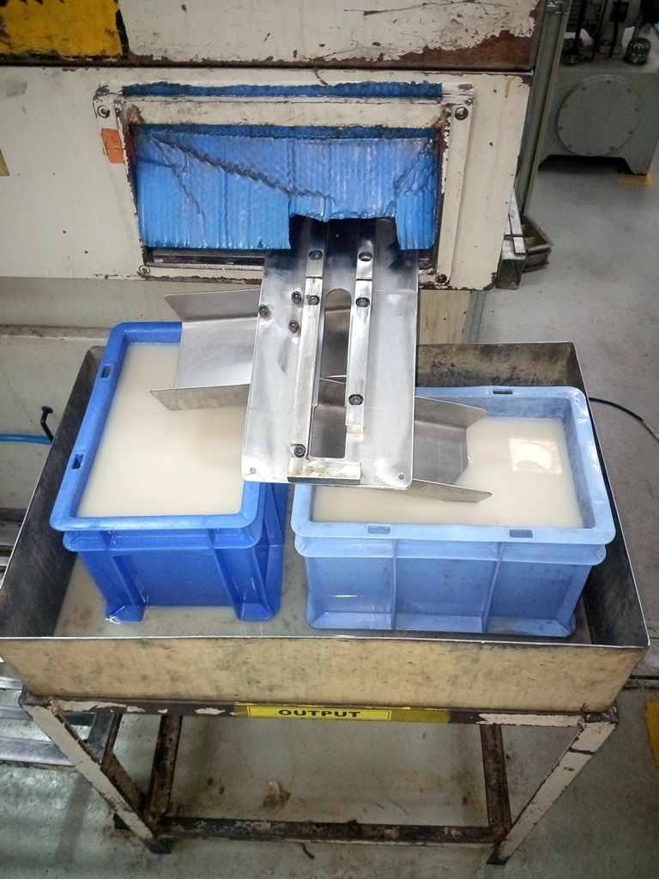
AHPL/QMS/FR/09/E
P15
KAIZEN NO :-
ACTIVITY
KK
QM
PM
JH
SHE
OT
DM
E&T
KAIZEN IDEA SHEET
TPM CIRCLE NAME:
LOSS NO. / STEP
DEPT :- MACHINE SHOP
RESULT AREA
P
Q
A,B,C
C
D
S
M
CELL:- Grinding
CELL NAME:- Rotor Grinding
MACHINE / STAGE :- Rimaco Grinding
OPERATION :- Surface grinding
KAIZEN THEME : To Reduce Rejection for Dent Damage.
IDEA :- After grinding finish rotor drop in water bin.
Problem / Present Status :-Rimaco -1 & 2 machine Rotor get damage due to rotor drop in bin then rotor metal to metal direct contact.
COUNTERMEASURE:- Out put rotor drop in water bin due to water avoid metal to metal direct contact and reduce gravitational force.
BENCHMARK
Dent rej. Reduce
TARGET
Zero dent rej.
KAIZEN START
02.05.2017
TDC
10.05.2017
KAIZEN FINISH
08-05-2017
TEAM MEMBERS : 1.Santosh Deshmukh
2. Sandip Jagtap
BENEFITS :-
1 .Dent damage rejection reduce.
Before
After
KAIZEN SUSTENANCE
WHY - WHY ANALYSIS :-
Why1 :-Finish output rotor drop in plastic bin.
Why2:- Rotor drop up to 300 mm distance
Why3 :-Rotor metal to metal direct contact.
Why4 :- Due to metal contact create dent.
RESULT :-
1) Rotor dent damage rejection reduce.
2) Operator rotor shorting time reduce incase of
rejection & rework during auto cycle.
3) Rotor 50 no’s lot after checking collect in finish bin.
4) Rotor cleaning activity done.
WHAT TO DO:-
1. Used two big height bin with full water level.
2. Provide stand for bin.
HOW TO DO:-
1.Check every shift operator will be maintain minimum rotor output stock up to 50 no’s in bin.
2. Bin water level up 80 %.
ROOT CAUSE :- Rotor metal to metal direct contact in output bin.
REGISTRATION NO. & DATE : 02.05.2017
SCOPE & PLAN FOR HORIZONTAL DEPLOYMENT
REGISTERED BY :- Santosh Deshmukh.
SR.
NO.
CELL
TARGET
RESPONSIBILITY
STATUS
MANAGER’S SIGN :- D. Y. Pawar
1
Rimaco -2
10-05-2017
SND
Done.
Rev.No:01 Rev Date:15.12.2016

